Slide 1
Cloud Skills Challenge
KUBERNETES BOOTCAMP

Slide 2
Kubernetes Bootcamp Agenda
1
WHY running a Cloud Skills Challenge in your organization?
2
WHAT to expect for the Cloud Skills Challenge – Kubernetes Bootcamp?
3
HOW to kick off the Kubernetes Bootcamp for your collaborators?
Notes:
For ESI customers, the TPM/iTPM must be consulted & provide approval before CSC is implemented. Be sure to always align with TPMs/iTPMs if you are considering running a challenge with ESI customers.
Andrea Waugh Metzger: LOVE Skills Challenge! I had a 60% conversion rate for ACAs last year when I ran challenges

Slide 3
Kubernetes Bootcamp Why running a Cloud Skills Challenge in your organization?
27% of total roles will be new by 2022 in comparison to 16% in 2018¹
62% of executives believe they need to retrain or replace more than a quarter of their workforce by 2023²
74% of employees ready to completely retrain in order to remain employable in the future³
2018
2022
Skill gaps lead to higher levels of stress, delays in development, deployment of critical projects, and even loss of revenue¹
Invest in upskilling and training your teams with engaging experiences
Reward employees that invest in learning
Prioritize certification in hiring and recruiting
World Economic Forum” The Future of Jobs & Skills
McKinsey Survey: Retraining and reskilling workers in the age of automation
PwC 2018 Saratoga: Rethinking HR for the future of work
Notes:
For ESI customers, the TPM/iTPM must be consulted & provide approval before CSC is implemented. Be sure to always align with TPMs/iTPMs if you are considering running a challenge with ESI customers.
Andrea Waugh Metzger: LOVE Skills Challenge! I had a 60% conversion rate for ACAs last year when I ran challenges

Slide 4
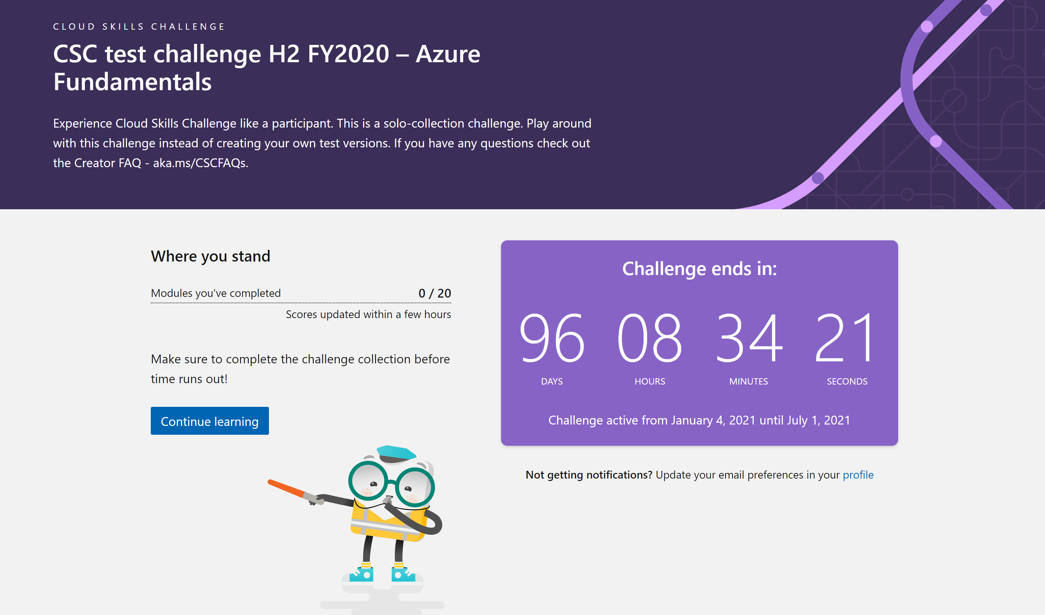
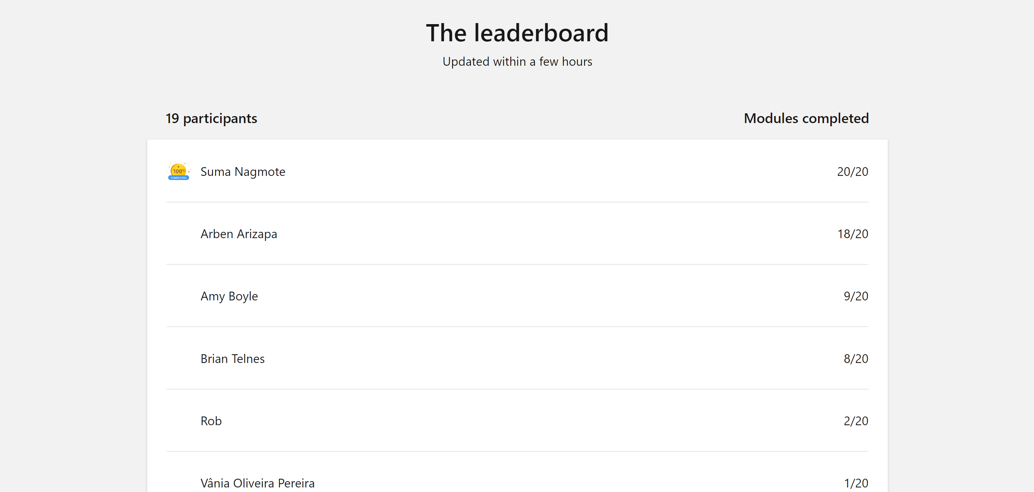
Kubernetes Bootcamp What to expect for the Cloud Skills Challenge – Kubernetes Bootcamp Edition?
Example
Gamified experience power by Microsoft Learn. The challenge has a timeline and a leaderboard with participants progress, ordered by completed modules.
Notes:
For ESI customers, the TPM/iTPM must be consulted & provide approval before CSC is implemented. Be sure to always align with TPMs/iTPMs if you are considering running a challenge with ESI customers.
Andrea Waugh Metzger: LOVE Skills Challenge! I had a 60% conversion rate for ACAs last year when I ran challenges

Slide 5
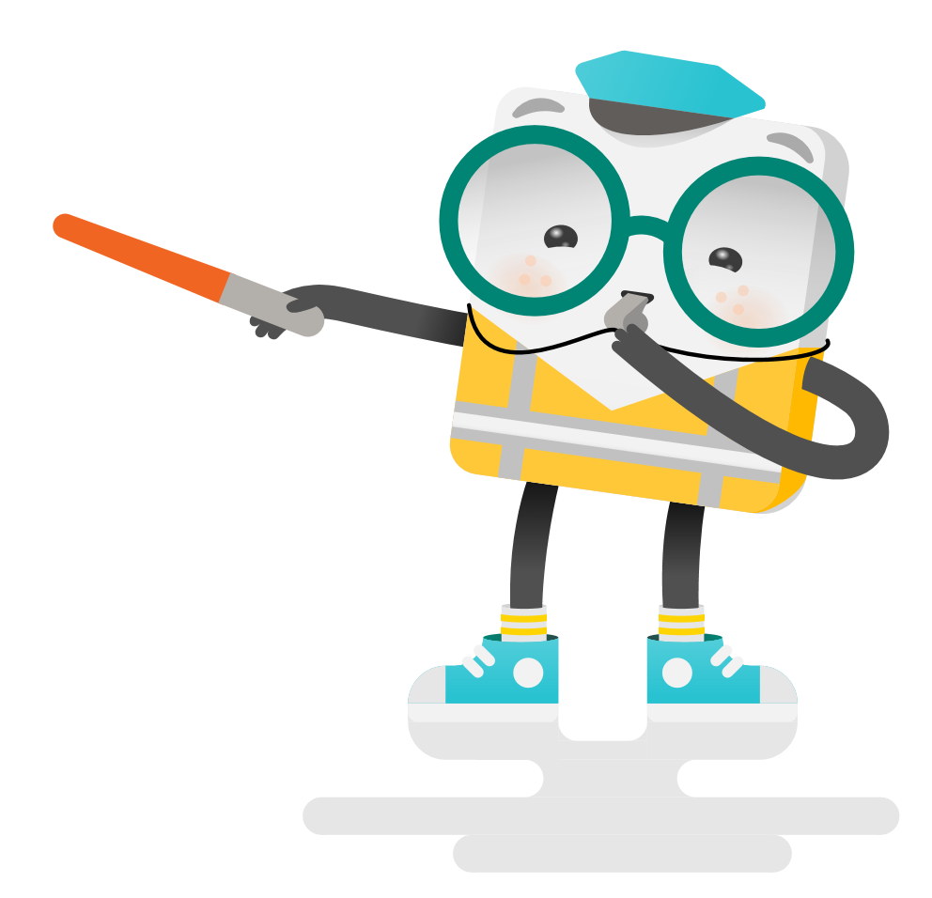
Kubernetes Bootcamp What to expect for the Cloud Skills Challenge – Kubernetes Bootcamp Edition?
4 weeks self-learning with gamification
Microsoft invites you for the Kubernetes Bootcamp powered by Microsoft Learn content. In just 4 weeks, you will understand the basics of Kubernetes and get Hands-On experience with its various components and capabilities, including AKS.
Go from zero to hero with Kubernetes to set your company up for future app development success.
Week 1
CONTAINERS WITH DOCKER & CONTAINERS WORKSHOP
2H30
Week 2
KUBERNETES INTRODUCTION
2H30
Week 3
DEVOPS FOR KUBERNETES
4H30
Week 4
KUBERNETES DEEPDIVE & KUBERNETES WORKSHOP
3H00
Notes:
For ESI customers, the TPM/iTPM must be consulted & provide approval before CSC is implemented. Be sure to always align with TPMs/iTPMs if you are considering running a challenge with ESI customers.
Andrea Waugh Metzger: LOVE Skills Challenge! I had a 60% conversion rate for ACAs last year when I ran challenges

Slide 6
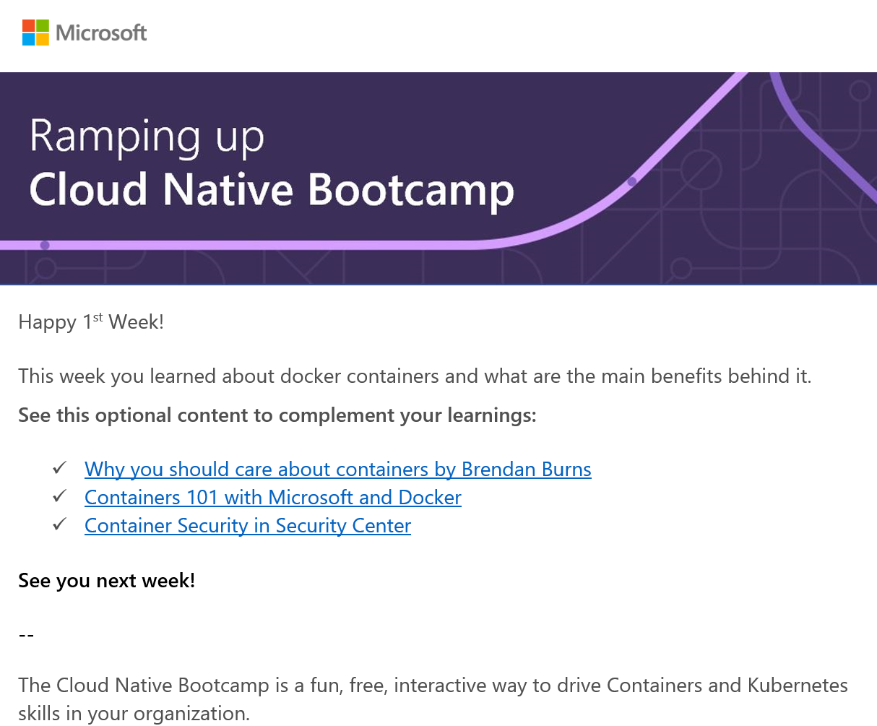
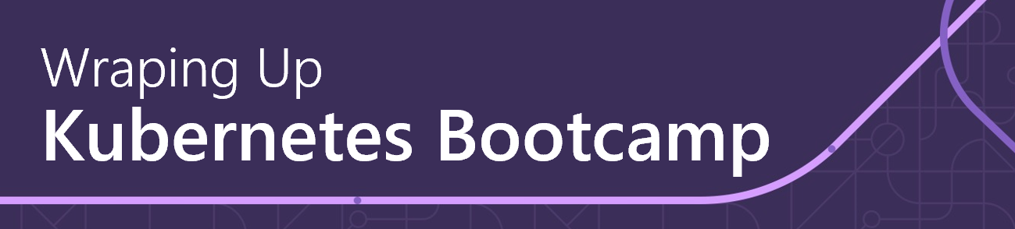
Kubernetes Bootcamp What to expect for the Cloud Skills Challenge – Kubernetes Bootcamp Edition?
Kick Off Session | TBD 2021
Weekly Check Up | TBD 2021
Weekly workshop/session to wrap up on the learning and additional content
Full Day Workshops | TBD 2021
Kubernetes Hands-On Workshop
Notes:
For ESI customers, the TPM/iTPM must be consulted & provide approval before CSC is implemented. Be sure to always align with TPMs/iTPMs if you are considering running a challenge with ESI customers.
Andrea Waugh Metzger: LOVE Skills Challenge! I had a 60% conversion rate for ACAs last year when I ran challenges

Slide 7
Kubernetes Bootcamp What to expect for the Cloud Skills Challenge – Kubernetes Bootcamp Edition?
Proposed Calendar
MON | TUE | WED | THU | FRI
 |  |  |  | Containers Workshop (Full Day)
 |  |  |  | Bootcamp Office Hours (1h30)
 |  |  |  | Bootcamp Office Hours (1h30)
 |  |  |  | Kubernetes Workshop (Full Day)
Containers 101 self-learning gamification, 2h30
Kubernetes & AKS 101 self-learning gamification, 2h30
DevOps for Kubernetes self-learning gamification, 4h30
Kubernetes Deep Dive self-learning gamification, 3h
Notes:
For ESI customers, the TPM/iTPM must be consulted & provide approval before CSC is implemented. Be sure to always align with TPMs/iTPMs if you are considering running a challenge with ESI customers.
Andrea Waugh Metzger: LOVE Skills Challenge! I had a 60% conversion rate for ACAs last year when I ran challenges

Slide 8
Kubernetes Bootcamp How to kick off the Kubernetes Bootcamp for your collaborators?
1
Choose a sponsor for your organization (IT Director, CIO, CTO)
2
Choose a date to start the Kubernetes Bootcamp
3
Send the invites and meetings requests provided by Microsoft to potential participants
4
Keep track of the leaderboard and encourage your collaborators together with Microsoft
Notes:
For ESI customers, the TPM/iTPM must be consulted & provide approval before CSC is implemented. Be sure to always align with TPMs/iTPMs if you are considering running a challenge with ESI customers.
Andrea Waugh Metzger: LOVE Skills Challenge! I had a 60% conversion rate for ACAs last year when I ran challenges

